Slide 1
Classification of Alcoholic and Control Individuals using Logistic Regression on EEG data
Avijit Saha (BS2109)
Tuhin Saha (BS2127)

Slide 2
CONTENTS:
Introduction
Dataset Description
Dataset Modification
Issues with the Change
Principal Component Analysis
Principal Component Analysis
Logistic Regression
Adding Dummy Variables
Initial Model
Updated Model
Accuracy of Models
Conclusion

Slide 3
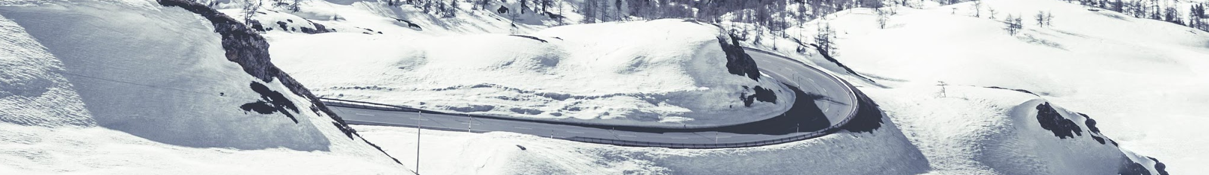
Introduction
The electroencephalogram (EEG) signal is an electrical representation of the brain’s working that reflects various physiological and pathological activities such as alcoholism.
Nowadays, the automatic identification of alcoholic subjects based on EEG signals has become one of the challenging problems in biomedical research.
The goal of this project is to determine whether a person is an alcoholic or not, given the EEG data of that person.

Slide 4
Dataset Description
This data arises from a large study to examine EEG correlates of genetic predisposition to alcoholism.
It contains measurements from 64 electrodes placed on the subject’s scalps sampled at 256 Hz for 1 second.
There were two groups of subjects: ”alcoholic” and ”control”.
Each subject was exposed to either a single stimulus (S1) or to two stimuli (S1 and S2). When two stimuli were shown, they were presented in either a matched condition where S1 was identical to S2 or in a non-matched condition where S1 differed from S2.

Slide 5
Dataset Description (Contd.)
Each trial is stored in a separate CSV file.
The columns of the data are:
• trial number • matching condition • name
• sensor position • channel number • time
• sample number • sensor value • subject identifier

Slide 6
Dataset Modification
In the raw dataset, we have 948 CSV files. Each file corresponds to a particular trial of a particular person.
Instead of taking the values of channel and frequency, we incorporate them into columns and take the sensor value in each instance as the value for that column.
For example, if some row has channel 43, frequency 68, and sensor value 6, then the corresponding column name would be C43_F68 and the value for that column would be 6.

Slide 7
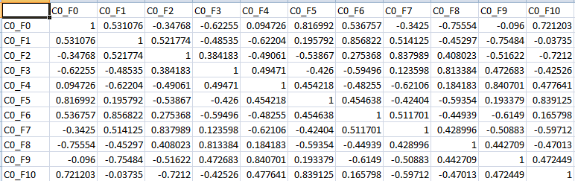
Issues with the Change
1
If we want to apply logistic regression to this, we would need the covariates to be linearly independent, otherwise, the model will not be unique. Indeed, in our case, the covariates are not independent.
2
The number of covariates is just ridiculously high. So, the model would be highly expensive in terms of space and time complexity.

Slide 8
What we need to do further, to be able to apply logistic regression:
We need to reduce the high dimensionality.
We also need to make some modifications so that the covariates may be independent, enabling us to obtain a unique model.

Slide 9
Principal Component Analysis

Slide 10
Principal Component Analysis
Principal Component Analysis is a standard method for the recognition of statistical design in order to reduce dimensionality and is used for feature extraction.
Applying PCA on the 948×16384 sensor value data matrix will give:
01 | 16384 dimensional mean of row vectors
02 | 947 orthogonal unit vectors of dimension 16384
03 | components of every row vector of data matrix along the row space spanning unit vectors as ‘scores’
04 | non-zero eigen-values of the covariance matrix of the sensor value data matrix

Slide 11
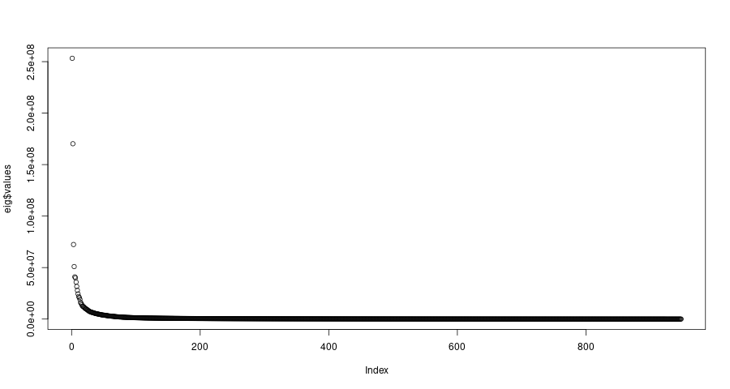
Principal Component Analysis (Contd.)
We have to reduce the dimensions of the data without losing much variability.
We are going to truncate the ‘scores’ matrix to get a 948 × 133 dimensional matrix

Slide 12

Logistic Regression

Slide 13
Adding Dummy Variables
The column for the matching condition is a categorical variable and it has 3 possible values.
We handle this by dummy variables. So, we make 3 new columns instead of the matching condition column - S1 obj, S2 match, and S2 nomatch. Now if a trial was for S1 obj, then the S1 obj value would be 1 and its value for the other two columns would be 0.
Similarly, we do the same for S2 match and S2 nomatch.
It is obvious that the sum of these values for these 3 columns in a row is 1. So, it makes sense to only add 2 of them, say we exclude S2 nomatch.

Slide 14
Initial Model
Deviance Residuals:
Min 1Q Median 3Q Max
-3.4874 -0.0911 0.0000 0.1142 2.5821
Coefficients:
Estimate Std. Error z value Pr(>|z|)
(Intercept) -9.562e-01 4.726e-01 -2.023 0.043035 *
S1.obj -4.699e-01 7.149e-01 -0.657 0.510934
S2.match 3.584e-01 6.418e-01 0.558 0.576507
X1 -1.263e-03 4.540e-04 -2.781 0.005414 **
X2 3.826e-05 5.024e-04 0.076 0.939289
X3 7.210e-03 1.131e-03 6.373 1.86e-10 ***
X4 -6.834e-03 1.334e-03 -5.124 2.99e-07 ***
X5 1.266e-03 1.136e-03 1.114 0.265335
X6 -2.079e-03 1.075e-03 -1.934 0.053160 .
X7 -8.295e-04 9.281e-04 -0.894 0.371450
X8 3.545e-03 1.260e-03 2.814 0.004888 **
X9 4.735e-03 1.247e-03 3.797 0.000146 ***
X10 -7.044e-03 1.616e-03 -4.358 1.31e-05 ***
X11 1.158e-02 1.937e-03 5.980 2.23e-09 ***
X12 -1.175e-02 2.002e-03 -5.872 4.32e-09 ***
X13 7.265e-03 1.612e-03 4.508 6.54e-06 ***
X14 2.325e-02 3.104e-03 7.490 6.88e-14 ***
X15 7.182e-03 1.947e-03 3.689 0.000225 ***
X16 6.270e-03 1.952e-03 3.213 0.001315 **
X17 1.018e-02 2.689e-03 3.786 0.000153 ***
X18 -2.221e-02 3.465e-03 -6.411 1.45e-10 ***
X19 -5.760e-03 2.443e-03 -2.357 0.018402 *

Slide 15
Initial Model (Contd.)
X20 -2.753e-03 2.257e-03 -1.220 0.222462
X21 8.633e-03 2.516e-03 3.432 0.000600 ***
X22 -4.731e-03 2.135e-03 -2.216 0.026701 *
X23 3.564e-03 2.085e-03 1.709 0.087472 .
X24 -3.892e-03 2.472e-03 -1.574 0.115399
X25 7.277e-03 2.420e-03 3.007 0.002637 **
X26 -4.040e-03 2.419e-03 -1.670 0.094857 .
X27 -6.615e-03 3.013e-03 -2.196 0.028123 *
X28 -4.407e-03 2.401e-03 -1.835 0.066475 .
X29 -1.862e-02 3.406e-03 -5.465 4.63e-08 ***
X30 5.550e-03 2.763e-03 2.008 0.044601 *
X31 6.366e-03 2.603e-03 2.445 0.014473 *
X32 -3.874e-03 2.603e-03 -1.488 0.136733
X33 -3.692e-03 2.754e-03 -1.341 0.180034
X34 -2.722e-03 2.531e-03 -1.076 0.282054
X35 -3.531e-03 2.973e-03 -1.188 0.234948
X36 -3.067e-03 2.885e-03 -1.063 0.287767
X37 6.229e-03 3.046e-03 2.045 0.040871 *
X38 7.017e-04 2.903e-03 0.242 0.808980
X39 -1.790e-03 2.853e-03 -0.627 0.530457
X40 8.995e-03 3.358e-03 2.679 0.007393 **
X41 9.059e-03 3.356e-03 2.699 0.006951 **
X42 1.038e-03 3.078e-03 0.337 0.735941
X43 -6.050e-03 2.987e-03 -2.025 0.042850 *
X44 -4.407e-03 3.528e-03 -1.249 0.211639
X45 -7.183e-03 3.229e-03 -2.225 0.026098 *
X46 6.999e-03 3.123e-03 2.241 0.025030 *
X47 -1.934e-03 3.514e-03 -0.550 0.582137

Slide 16
Initial Model (Contd.)
X48 -1.086e-02 3.963e-03 -2.741 0.006132 **
X49 1.209e-03 3.349e-03 0.361 0.718095
X50 1.079e-02 3.722e-03 2.898 0.003751 **
X51 -4.292e-03 3.488e-03 -1.231 0.218483
X52 -2.561e-02 4.854e-03 -5.277 1.32e-07 ***
X53 -1.149e-02 4.307e-03 -2.668 0.007629 **
X54 2.092e-02 4.187e-03 4.996 5.85e-07 ***
X55 -3.193e-03 4.061e-03 -0.786 0.431727
X56 -4.413e-04 3.731e-03 -0.118 0.905868
X57 -2.783e-02 4.849e-03 -5.739 9.51e-09 ***
X58 -1.175e-03 3.836e-03 -0.306 0.759406
X59 -5.569e-03 4.018e-03 -1.386 0.165696
X60 1.724e-02 4.444e-03 3.879 0.000105 ***
X61 1.202e-02 4.052e-03 2.967 0.003007 **
X62 -7.776e-03 3.994e-03 -1.947 0.051524 .
X63 1.119e-02 4.469e-03 2.505 0.012252 *
X64 1.164e-03 4.479e-03 0.260 0.795045
X65 7.716e-03 4.576e-03 1.686 0.091726 .
X66 -1.280e-03 4.599e-03 -0.278 0.780701
X67 -3.123e-02 5.973e-03 -5.229 1.71e-07 ***
X68 4.982e-03 4.592e-03 1.085 0.277952
X69 3.349e-03 4.251e-03 0.788 0.430808
X70 8.529e-03 5.099e-03 1.673 0.094397 .
X71 1.021e-02 4.655e-03 2.194 0.028245 *
X72 -1.551e-03 5.468e-03 -0.284 0.776673
X73 -1.399e-02 5.373e-03 -2.604 0.009202 **
X74 -2.914e-02 6.240e-03 -4.670 3.01e-06 ***
X75 2.090e-02 5.259e-03 3.974 7.06e-05 ***

Slide 17
Initial Model (Contd.)
X76 1.376e-03 4.811e-03 0.286 0.774930
X77 7.502e-03 5.210e-03 1.440 0.149879
X78 2.120e-03 5.183e-03 0.409 0.682494
X79 -1.582e-02 5.720e-03 -2.765 0.005694 **
X80 -2.412e-02 5.683e-03 -4.245 2.19e-05 ***
X81 5.691e-03 4.704e-03 1.210 0.226360
X82 -1.558e-03 5.541e-03 -0.281 0.778626
X83 7.326e-03 4.857e-03 1.508 0.131495
X84 1.032e-02 5.360e-03 1.925 0.054167 .
X85 8.853e-04 6.169e-03 0.144 0.885895
X86 9.383e-03 5.512e-03 1.702 0.088679 .
X87 9.470e-03 5.517e-03 1.716 0.086088 .
X88 -8.917e-03 5.279e-03 -1.689 0.091200 .
X89 1.196e-02 5.669e-03 2.110 0.034875 *
X90 -1.014e-02 5.506e-03 -1.841 0.065559 .
X91 2.003e-02 6.158e-03 3.253 0.001141 **
X92 3.671e-03 5.365e-03 0.684 0.493802
X93 1.249e-02 5.753e-03 2.170 0.029984 *
X94 1.286e-02 5.023e-03 2.560 0.010475 *
X95 2.412e-03 6.103e-03 0.395 0.692686
X96 -2.423e-02 5.874e-03 -4.125 3.71e-05 ***
X97 5.742e-03 5.825e-03 0.986 0.324232
X98 3.042e-02 7.041e-03 4.320 1.56e-05 ***
X99 -6.412e-03 5.298e-03 -1.210 0.226129
X100 -9.961e-03 6.164e-03 -1.616 0.106121
X101 2.635e-03 6.302e-03 0.418 0.675854
X102 2.161e-02 6.065e-03 3.563 0.000367 ***
X103 3.258e-02 7.136e-03 4.566 4.97e-06 ***

Slide 18
Initial Model (Contd.)
X104 -1.294e-02 5.862e-03 -2.208 0.027229 *
X105 8.796e-03 6.016e-03 1.462 0.143691
X106 6.470e-03 6.198e-03 1.044 0.296532
X107 2.330e-03 6.019e-03 0.387 0.698717
X108 7.750e-03 6.526e-03 1.188 0.235002
X109 6.606e-03 6.476e-03 1.020 0.307718
X110 -3.515e-03 7.006e-03 -0.502 0.615865
X111 -2.111e-03 6.681e-03 -0.316 0.752042
X112 1.012e-02 6.336e-03 1.598 0.110135
X113 -3.543e-03 6.142e-03 -0.577 0.564010
X114 -1.277e-02 6.662e-03 -1.918 0.055160 .
X115 -5.254e-03 6.474e-03 -0.812 0.417043
X116 2.765e-02 6.806e-03 4.063 4.84e-05 ***
X117 -3.731e-02 7.905e-03 -4.720 2.35e-06 ***
X118 -5.699e-05 6.364e-03 -0.009 0.992854
X119 1.373e-03 6.698e-03 0.205 0.837609
X120 4.506e-02 7.975e-03 5.650 1.60e-08 ***
X121 1.386e-03 6.626e-03 0.209 0.834282
X122 -3.179e-03 6.615e-03 -0.481 0.630838
X123 -1.139e-02 7.295e-03 -1.562 0.118291
X124 -1.340e-02 6.887e-03 -1.946 0.051682 .
X125 2.595e-02 7.045e-03 3.683 0.000230 ***
X126 -1.571e-02 6.486e-03 -2.422 0.015429 *
X127 1.055e-02 6.625e-03 1.592 0.111390
X128 -1.253e-02 7.068e-03 -1.772 0.076353 .
X129 -1.013e-03 7.829e-03 -0.129 0.897100
X130 6.723e-03 7.559e-03 0.889 0.373773
X131 -2.279e-02 6.876e-03 -3.314 0.000919 ***

Slide 19
Initial Model (Contd.)
X132 1.165e-02 7.193e-03 1.619 0.105458
X133 -3.283e-02 7.697e-03 -4.265 2.00e-05 ***
---
Signif. codes: 0 ‘***’ 0.001 ‘**’ 0.01 ‘*’ 0.05 ‘.’ 0.1 ‘ ’ 1
(Dispersion parameter for binomial family taken to be 1)
Null deviance: 1048.0 on 755 degrees of freedom
Residual deviance: 287.2 on 620 degrees of freedom
AIC: 559.2
Number of Fisher Scoring iterations: 9

Slide 20
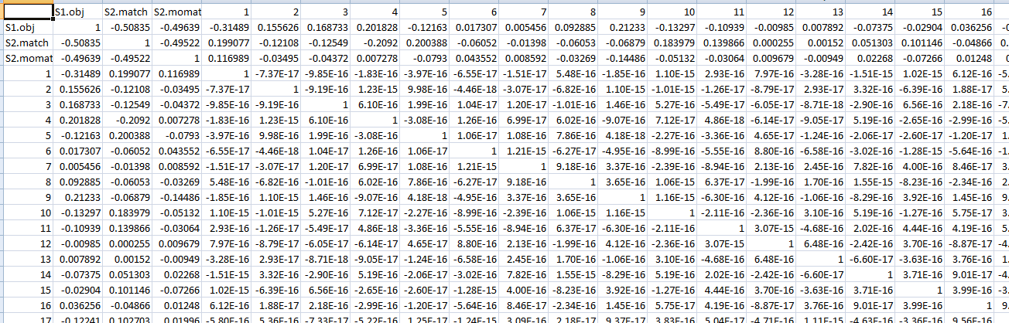
Remarks
1
The summary of the model suggests that most of the covariate principal components are insignificant in this model. Though the number of covariates has been reduced down to 135, this number is still quite large.
2
There is no significant contribution from ”S1 obj” and ”S2 match”. The influence of the matching condition is not much as was expected earlier. This can be explained by the following correlation matrix.

Slide 21
Updated Model
Using significant variables of initial model
Deviance Residuals:
Min 1Q Median 3Q Max
-2.6000 -0.6404 0.0569 0.6361 3.4420
Coefficients:
Estimate Std. Error z value Pr(>|z|)
(Intercept) -0.2241429 0.1030265 -2.176 0.029586 *
X3 0.0022803 0.0003997 5.705 1.16e-08 ***
X4 -0.0024270 0.0004715 -5.148 2.64e-07 ***
X10 -0.0017227 0.0006478 -2.659 0.007835 **
X11 0.0052314 0.0007718 6.779 1.21e-11 ***
X12 -0.0041955 0.0007886 -5.320 1.04e-07 ***
X13 0.0023867 0.0007229 3.302 0.000961 ***
X14 0.0086102 0.0009652 8.920 < 2e-16 ***
X18 -0.0068978 0.0010057 -6.859 6.95e-12 ***
X29 -0.0058896 0.0012767 -4.613 3.97e-06 ***
X52 -0.0087851 0.0017259 -5.090 3.58e-07 ***
X54 0.0085811 0.0017576 4.882 1.05e-06 ***
X57 -0.0081921 0.0017985 -4.555 5.24e-06 ***
X67 -0.0087531 0.0021070 -4.154 3.26e-05 ***
X74 -0.0083934 0.0023231 -3.613 0.000303 ***
X75 0.0102005 0.0023191 4.399 1.09e-05 ***
X80 -0.0082447 0.0024512 -3.364 0.000770 ***
X96 -0.0069614 0.0027620 -2.520 0.011723 *
X98 0.0058844 0.0028549 2.061 0.039289 *
X103 0.0122848 0.0029778 4.125 3.70e-05 ***
X116 0.0078587 0.0031058 2.530 0.011394 *
X117 -0.0123944 0.0031812 -3.896 9.78e-05 ***

Slide 22
Updated Model (Contd.)
Using significant variables of initial model
X120 0.0159639 0.0033222 4.805 1.55e-06 ***
X133 -0.0113184 0.0035451 -3.193 0.001410 **
---
Signif. codes: 0 ‘***’ 0.001 ‘**’ 0.01 ‘*’ 0.05 ‘.’
0.1 ‘ ’ 1
Dispersion parameter for binomial family taken to be 1)
Null deviance: 1048.02 on 755 degrees of freedom
Residual deviance: 632.14 on 732 degrees of freedom
AIC: 680.14
Number of Fisher Scoring iterations: 6
From null deviance and residual deviance, we observe that our model has a 𝜒² value of 415.82 with 23 degrees of freedom.
Our model has a p-value less than 0.000001, which shows a high significance of our updated model.
We calculated McFadden’s R-squared and it comes out to be 0.397 which is quite good in this aspect.

Slide 23
Accuracy of Models (by Confusion Matrix)
The null hypothesis is ”The subject is not alcoholic”.
The Type-I error probability is less than 12.5% for initial model and 14.5% for updated model.
Through this update of model, more than 100 extra covariates are avoided only losing 4% accuracy.
Confusion Matrix of Initial Model
84.9%
predict_reg
0 1
0 85 12
1 17 78
Incididunt ut labore et dolore sed do eiusmod tempor incididunt ut labore et dolore magna aliqua.
Confusion Matrix of Updated Model
81.25%
predict_reg_update
0 1
0 83 14
1 22 73
Tempor incididunt labore et dolore sed do eiusmod tempor incididunt ut labore et dolore magna aliqua.

Slide 24
Conclusion
So, in this project, we demonstrated the use of logistic regression to classify between alcoholic and non-alcoholic people. A natural question that arises is how that may be of practical use.
In some medical procedures, doctors administer steroids to patients and their dosage varies depending on various factors and one of these factors is whether the patient is alcoholic or not. The patient may not tell the truth due to societal pressure or some other reason and the resulting consequence can be fatal. So, here is one possible application of our project.
In fact, the same techniques may be applied to derive a similar model for the effects of smoking and other drugs.

Slide 25
Thank you.

